Slide 1


DieHarder: Securing the Heap
Gene Novark & Emery Berger
University of Massachusetts, Amherst
[CCS 2010, WOOT 2011]

Slide 2


Slide 3

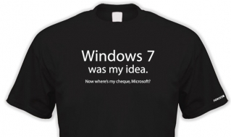
DieHard: Probabilistic Memory Safety for C/C++ Programs [PLDI 2005]
Direct inspiration for Windows 7’s Fault-Tolerant Heap (2009)
Notes:
Before DieHarder, there was DieHard.

Slide 4
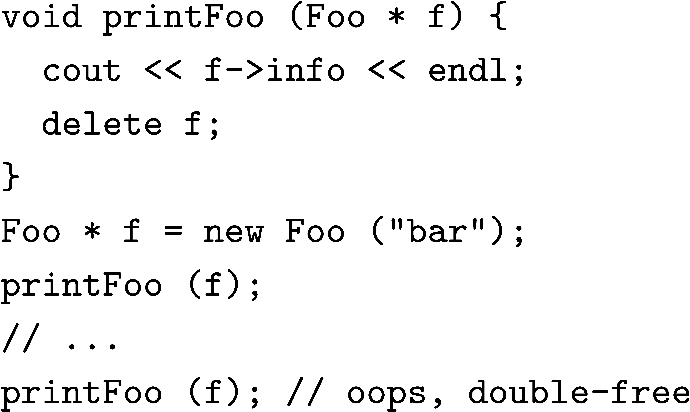
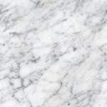
DieHard: Probabilistic Memory Safety for C/C++ Programs [PLDI 2005]
Notes:
So what was DieHard? Heap replacement for reliability.

Slide 5
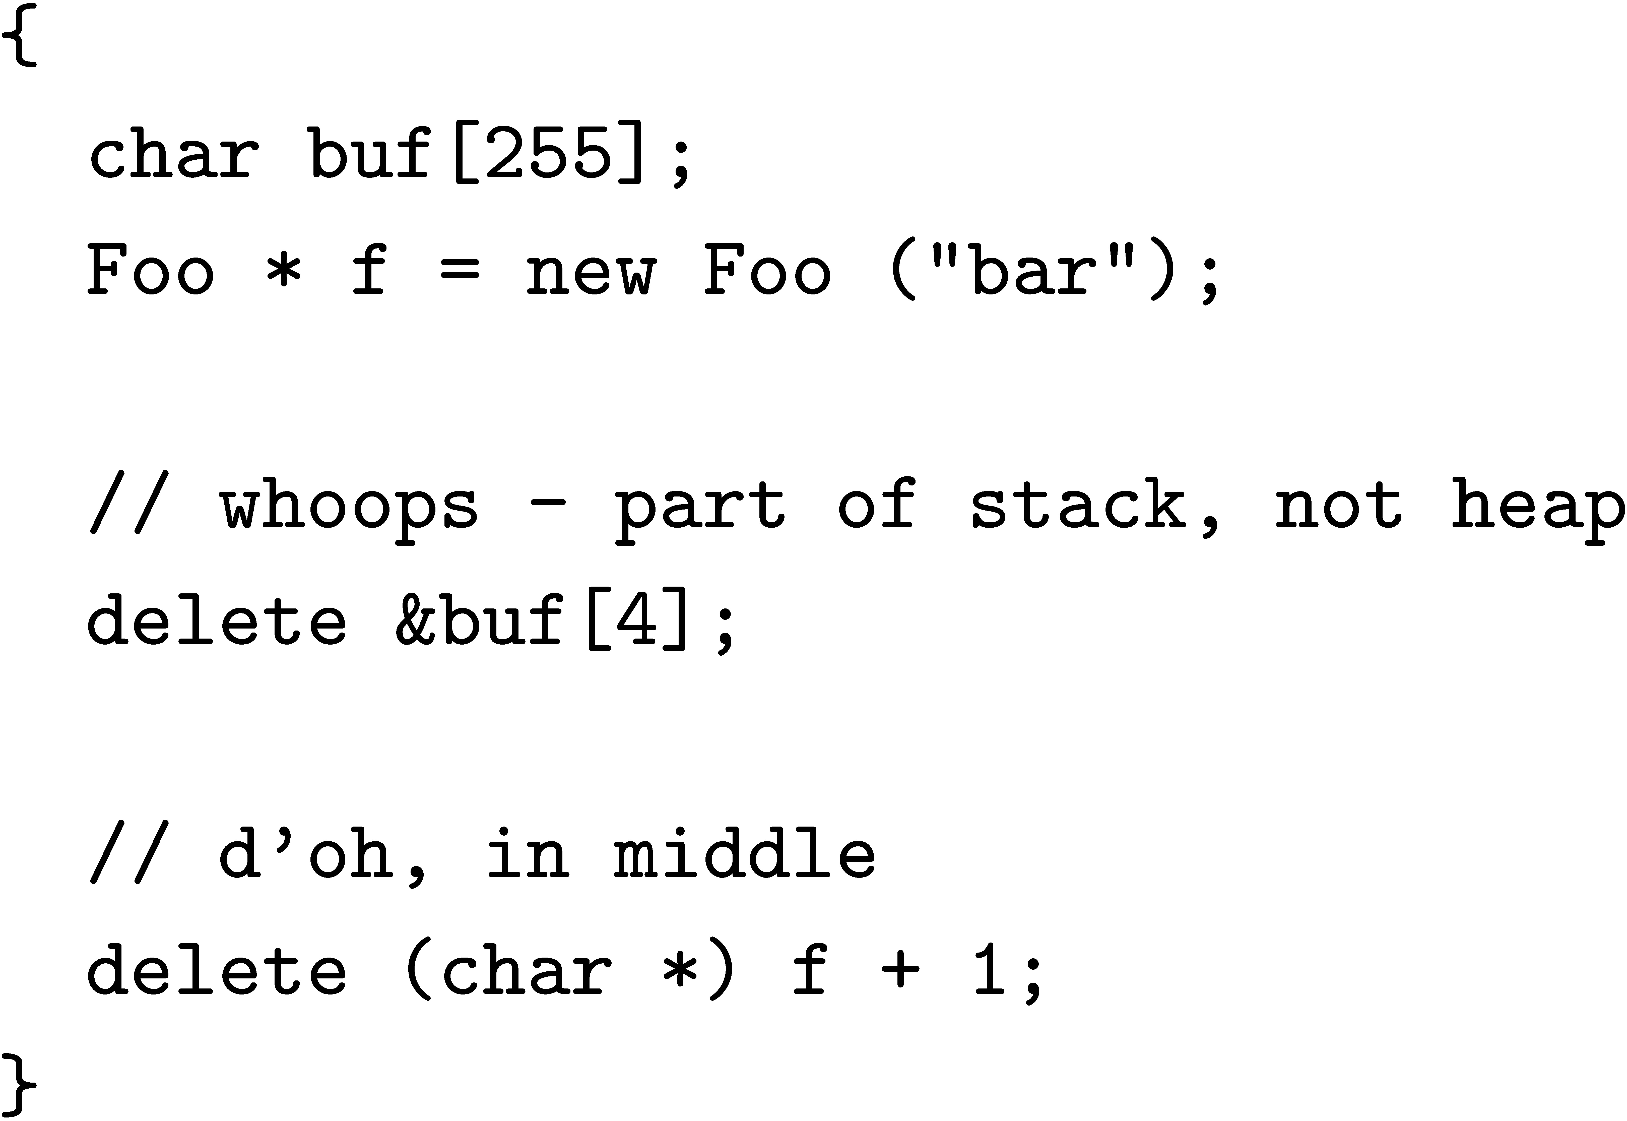
DieHard: Probabilistic Memory Safety for C/C++ Programs [PLDI 2005]
Notes:
So what was DieHard? Heap replacement for reliability.

Slide 6
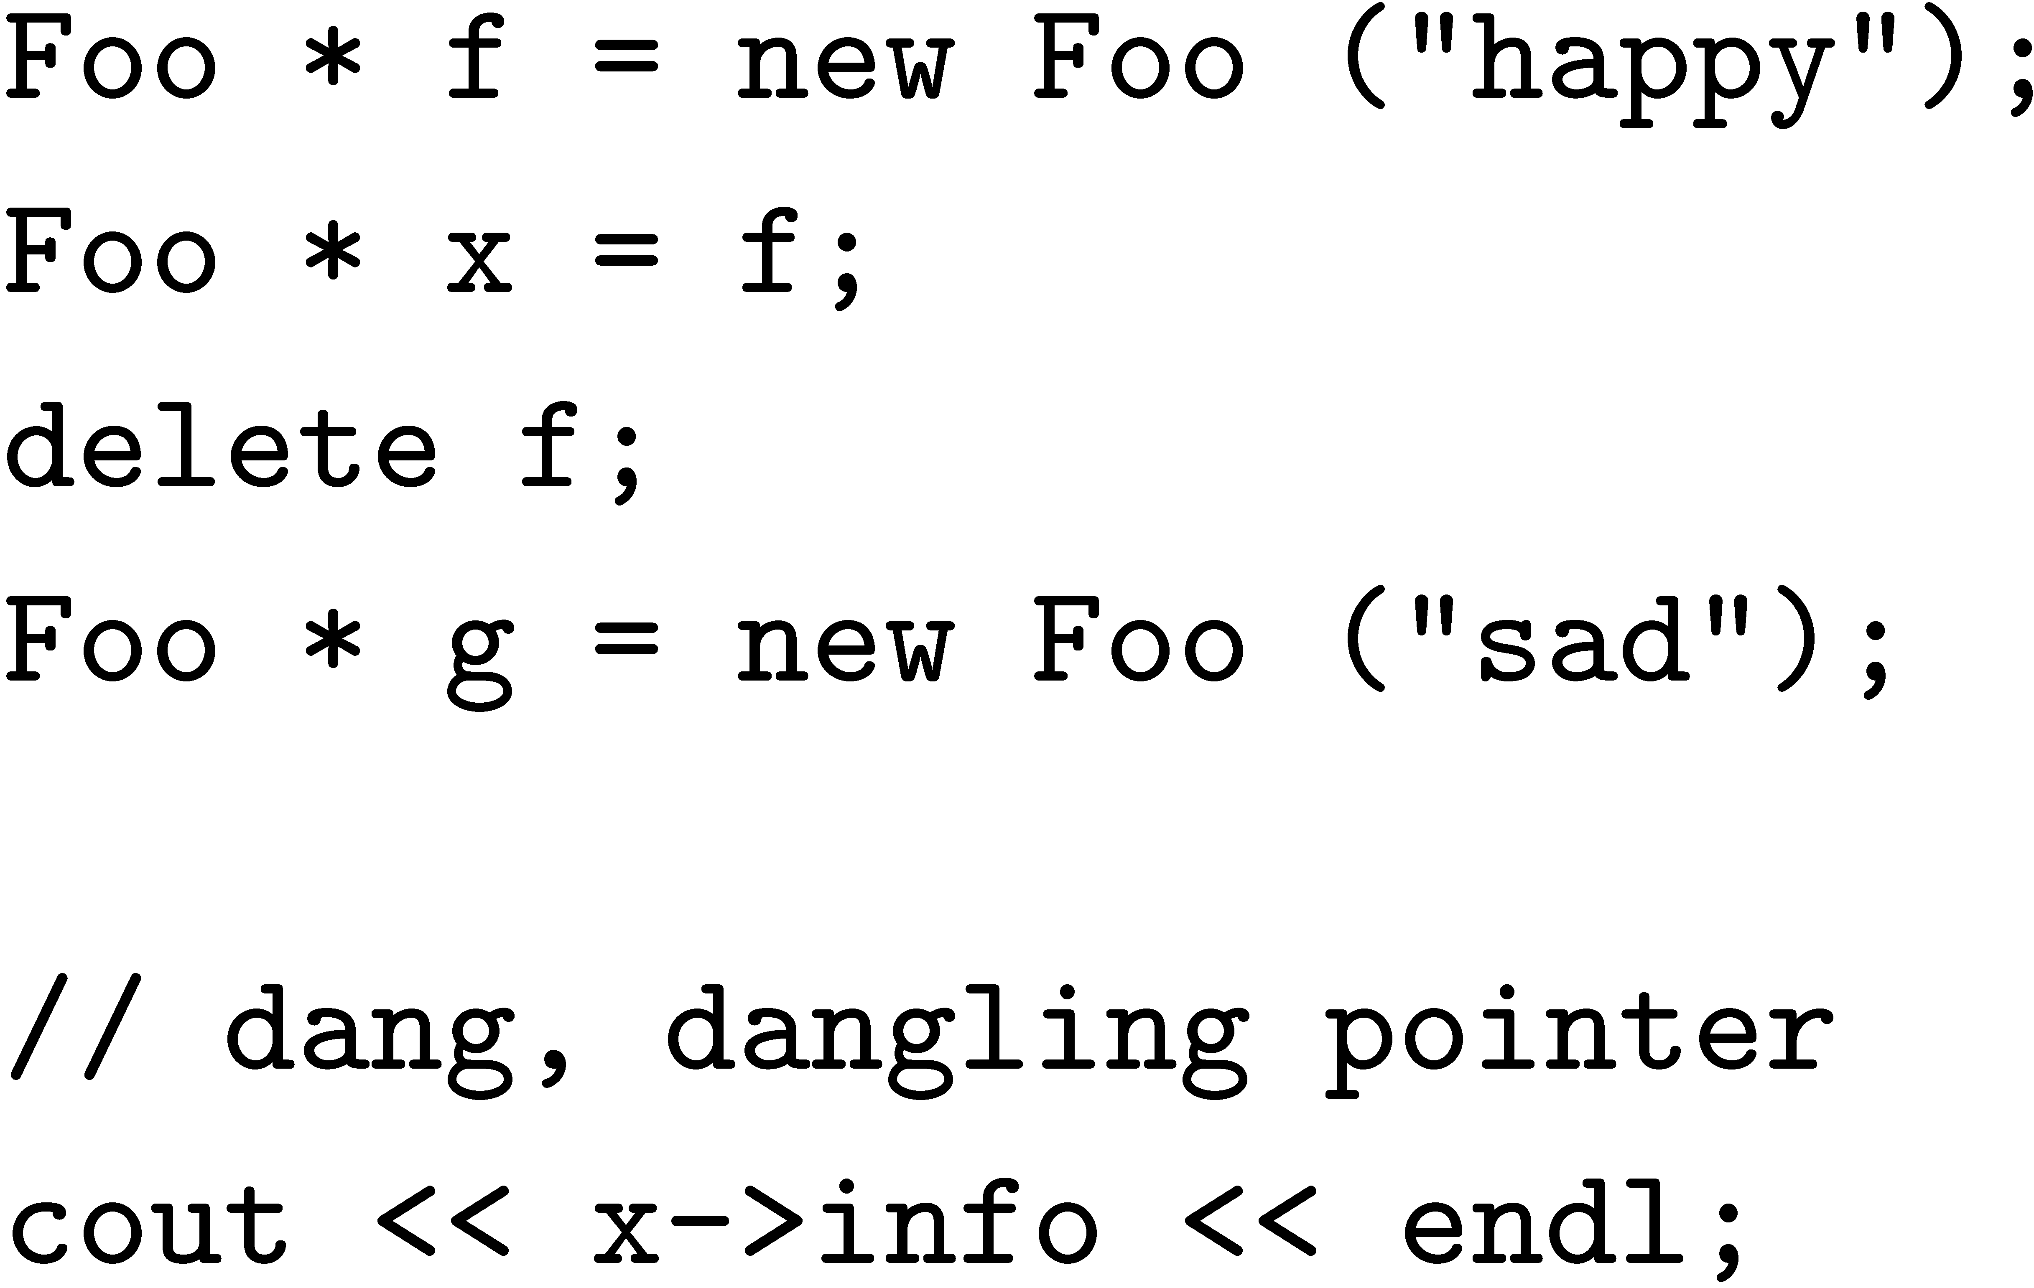
DieHard: Probabilistic Memory Safety for C/C++ Programs [PLDI 2005]
Notes:
So what was DieHard? Heap replacement for reliability.

Slide 7
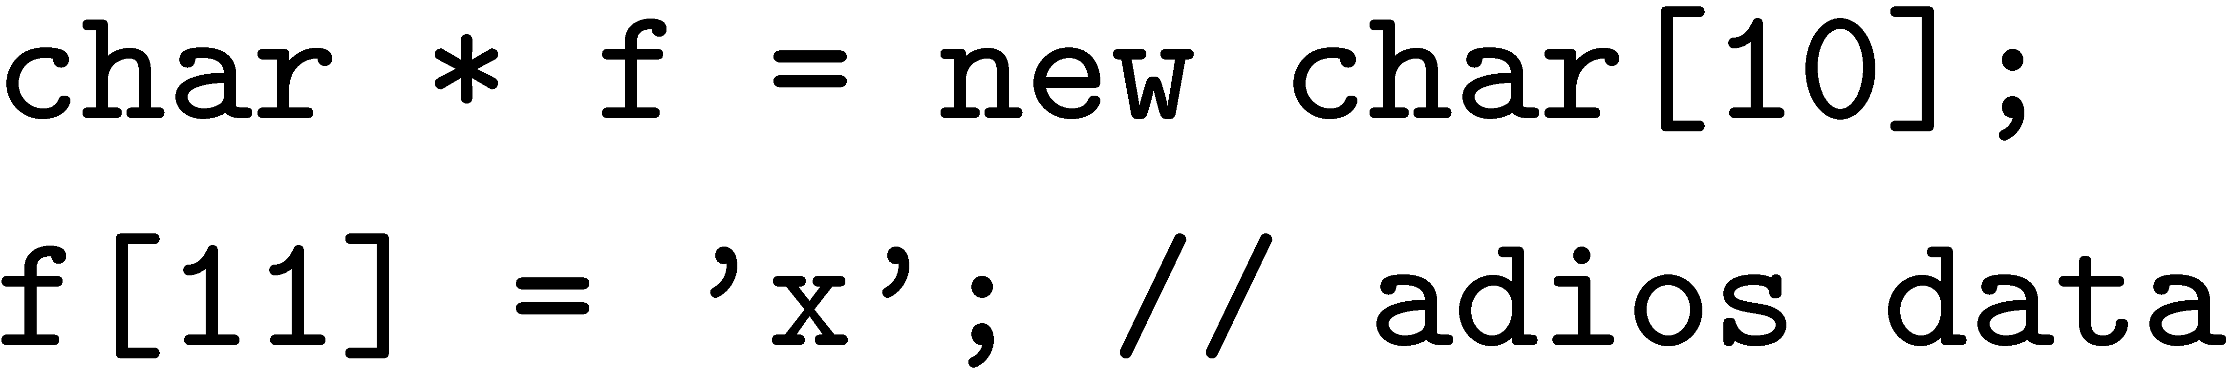
DieHard: Probabilistic Memory Safety for C/C++ Programs [PLDI 2005]
Notes:
So what was DieHard? Heap replacement for reliability.

Slide 8
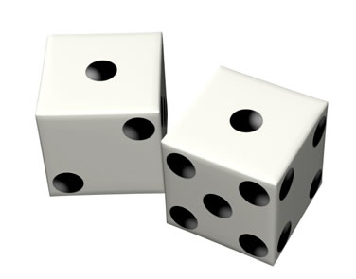
DieHard: Probabilistic Memory Safety for C/C++ Programs [PLDI 2005]
00000000
1010
10
metadata
size = 2^{i+3}
2^{i+4}
2^{i+5}
heap
Notes:
So what was DieHard? Heap replacement for reliability. Bitmap-based layout (one bit per object), RANDOMLY allocated.

Slide 9
DieHard: Probabilistic Memory Safety for C/C++ Programs [PLDI 2005]
00000000
1010
10
metadata
size = 2^{i+3}
2^{i+4}
2^{i+5}
heap
Notes:
Random allocation…pick one unset bit.

Slide 10
DieHard: Probabilistic Memory Safety for C/C++ Programs [PLDI 2005]
00000001
1010
10
metadata
size = 2^{i+3}
2^{i+4}
2^{i+5}
heap
Notes:
…and set it.

Slide 11
DieHard: Probabilistic Memory Safety for C/C++ Programs [PLDI 2005]
00000001
1010
10
metadata
size = 2^{i+3}
2^{i+4}
2^{i+5}
heap
Notes:
Allocate another one… What does this buy you? PREVENT double frees, PREVENT invalid frees.

Slide 12
DieHard: Probabilistic Memory Safety for C/C++ Programs [PLDI 2005]
00010001
1010
10
metadata
size = 2^{i+3}
2^{i+4}
2^{i+5}
heap
Notes:
PROBABILISTICALLY avoid buffer overflows.

Slide 13
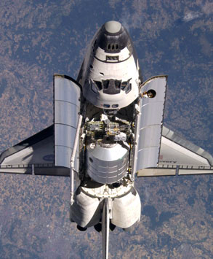
DieHard: Probabilistic Memory Safety for C/C++ Programs [PLDI 2005]
00000001
1010
10
metadata
size = 2^{i+3}
2^{i+4}
2^{i+5}
heap
Notes:
And really cut down on DANGLING POINTERS (UNLIKELY to reuse same object SOON). Performance is really good, and you can even REPLICATE executions to get higher reliability, a la the Space Shuttle (voting).

Slide 14


DieHard: Probabilistic Memory Safety for C/C++ Programs [PLDI 2005]
Notes:
SEVERELY watered down. Adopted many of features that make DieHard resilient to failure, and makes it fault tolerant, but

Slide 15
Notes:
DieHard uses randomization to provide probabilistic memory safety, but MS decided they didn’t want randomness

Slide 16
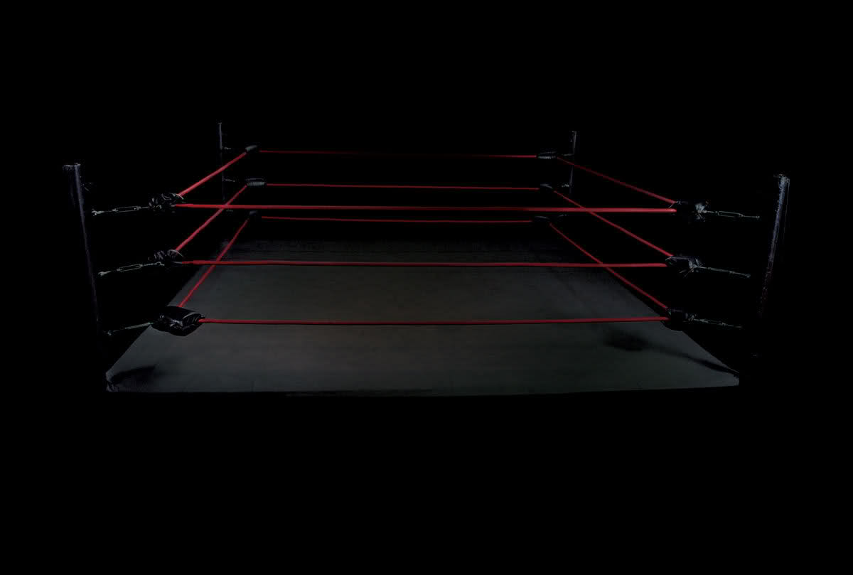

Notes:
Now planning for Windows 8. Fault tolerant vs. secure. Randomness needed?

Slide 17
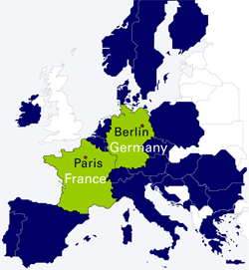

Slide 19


Slide 25
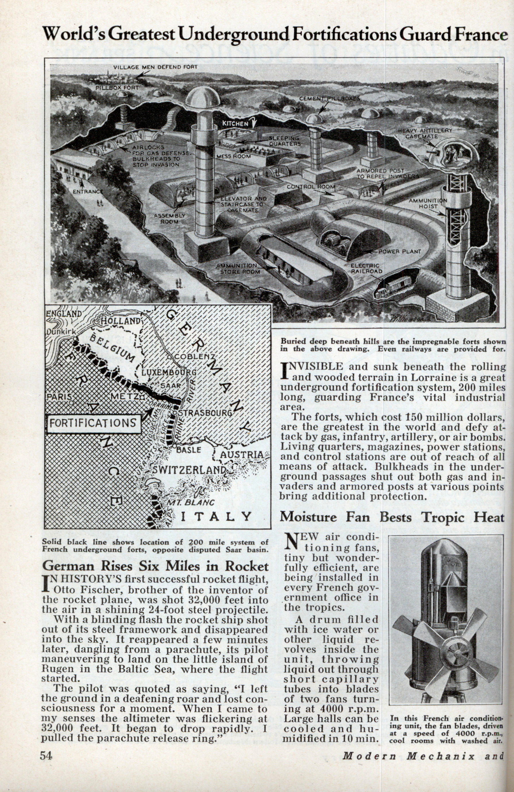

Slide 26
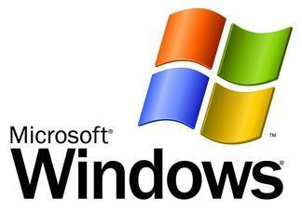
Notes:
I mean, Windows

Slide 29
Notes:
So the big question between counterattacks & the next attack is…

Slide 30

Notes:
So the big question between counterattacks & the next attack is…

Slide 31
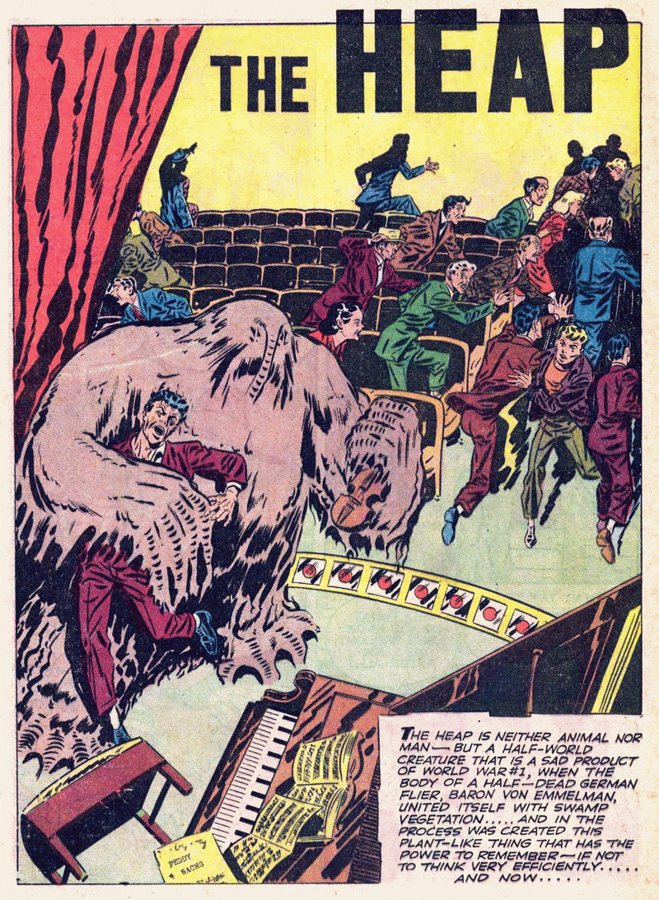
Notes:
Today we are focusing on the heap – a clear threat

Slide 32
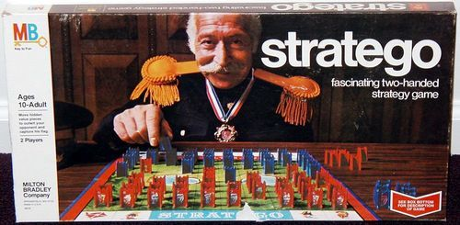
Notes:
Rather than talk technical about the heap internals - stratego

Slide 33
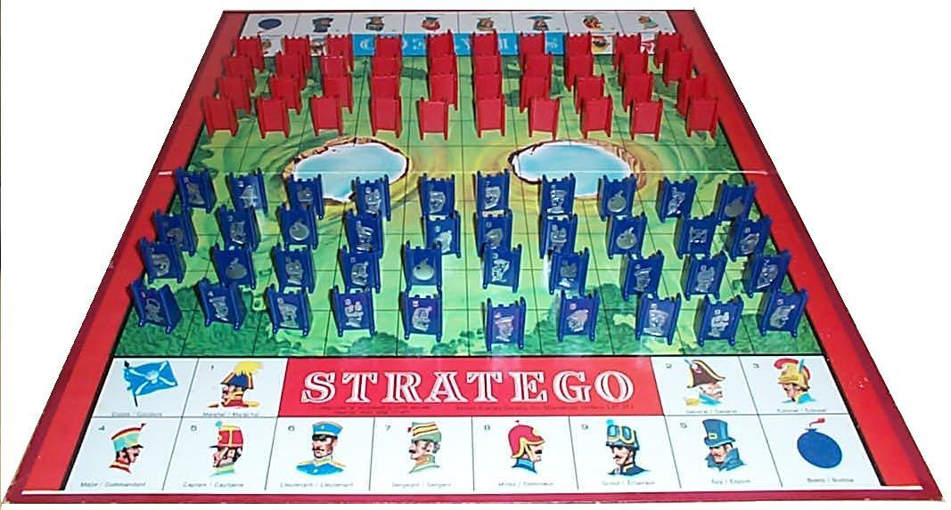
Notes:
If you haven’t played, here’s the way it works…

Slide 34
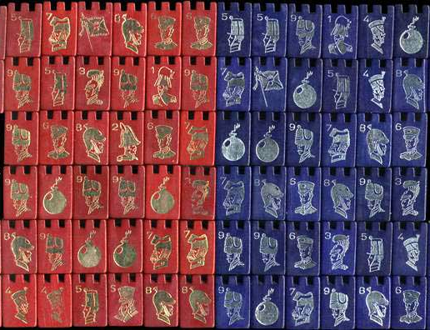
Notes:
There are lots of pieces in the original game…

Slide 35
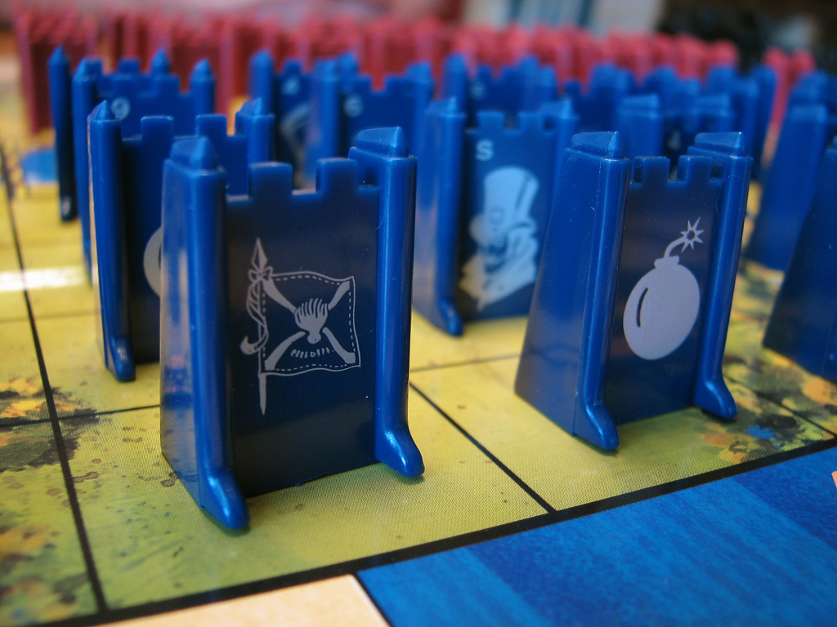
Notes:
Essentially a game of “capture the flag”. In this talk, we’re going to pretend that the only pieces are flags and bombs. If you hit a flag, you win. If you hit a bomb, you die.

Slide 36
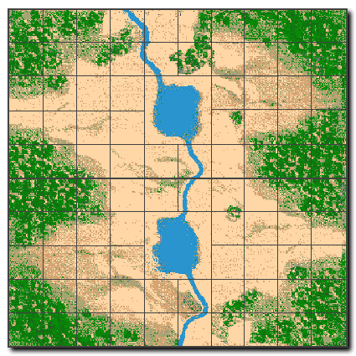
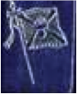
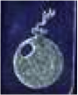
Notes:
Suppose this is the board layout.

Slide 37
Notes:
If the attacker hits the flag, …

Slide 38
Notes:
Pwned.

Slide 39
Notes:
However…

Slide 40
Notes:
If he hits the bomb...

Slide 41
Notes:
Then “the good guys” win.

Slide 42
Notes:
So to be concrete…

Slide 43
sensitive data
Notes:
The flags are sensitive data – but it turns out practically everything on the heap is sensitive! (metadata)

Slide 44
object
free space
heap metadata

Slide 45
prev. object
object size
object
free space
heap metadata
(GNU libc, Win, …)

Slide 46
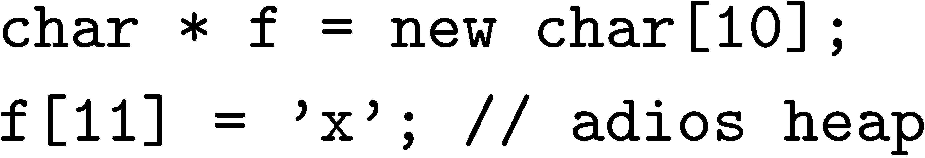
object
x
free space
heap metadata

Slide 47
object
x
free space
heap metadata

Slide 48
sensitive data
All data / metadata sensitive
Notes:
In our model, we assume conservatively that *all* data / metadata is sensitive.

Slide 49
guard / unmapped page
Notes:
And each bomb is either a guard page (mprotected) or an unmapped page, so a write or read into this space…

Slide 50
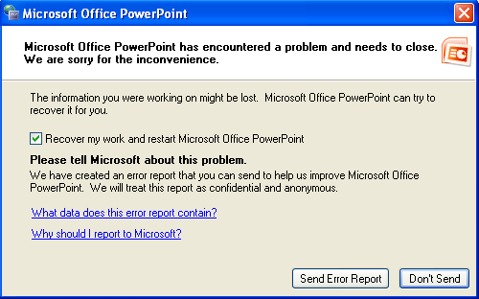
guard / unmapped page
Notes:
Does this.

Slide 51

Notes:
This is how it works for Windows

Slide 52
Notes:
This is how it works for Windows

Slide 53
Notes:
This is how it works for Windows

Slide 54
Address-space layout randomization
Notes:
This is how it works for Windows

Slide 55
Notes:
This is how it works for Windows

Slide 56
Notes:
This is how it works for Windows

Slide 57
Notes:
This is how it works for Windows

Slide 58
Notes:
This is how it works for Windows

Slide 59
Notes:
This is how it works for Windows

Slide 60
object size
allocation space
8
1
2
4
3
6
5
inUse
6
inUse
inUse
bitmap
2
4
16
1
inUse
miniheaps
1
inUse
1
Notes:
This is how it works for Windows

Slide 61
Notes:
This is how it works for Windows

Slide 62
Notes:
This is how it works for Windows

Slide 63

Notes:
This is how it works for Windows

Slide 64
Notes:
This is how it works for Windows

Slide 65
Notes:
This is how it works for Windows

Slide 66
Notes:
This is how it works for Windows

Slide 67
Notes:
This is how it works for Windows

Slide 68
≈ 4-5 bits of entropy
Notes:
This is how it works for Windows

Slide 69
DIE HARDER
Notes:
This is how it works for Windows

Slide 70
Maximal entropy: log N bits (e.g., ≈ 25-30)
DIE HARDER
Notes:
This is how it works for Windows

Slide 71
DIE HARDER
Notes:
This is how it works for Windows

Slide 72
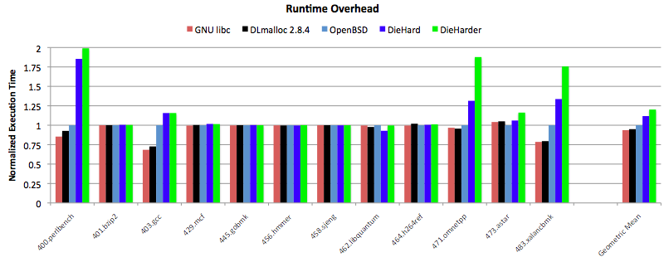

Slide 73

DIE HARDER

Slide 74
44.2 sec
DIE HARDER

Slide 75
44.2 sec
41.6 sec
DIE HARDER

Slide 76
DieHarder: Securing the Heap
Gene Novark & Emery Berger
University of Massachusetts, Amherst

Slide 77
char * str = new char[8];
strcpy (str, “goodbye cruel world”);

Slide 78
int * v = new int[4];
…
delete [] v; // oops
…
char * str = new char[16];
strcpy (str, “die, pointer”);
v[3] = 12;
… use of v[0]

Slide 79
Buffer Overflows: Data Corruption
object
object
x
Bug corrupts application data

Slide 80
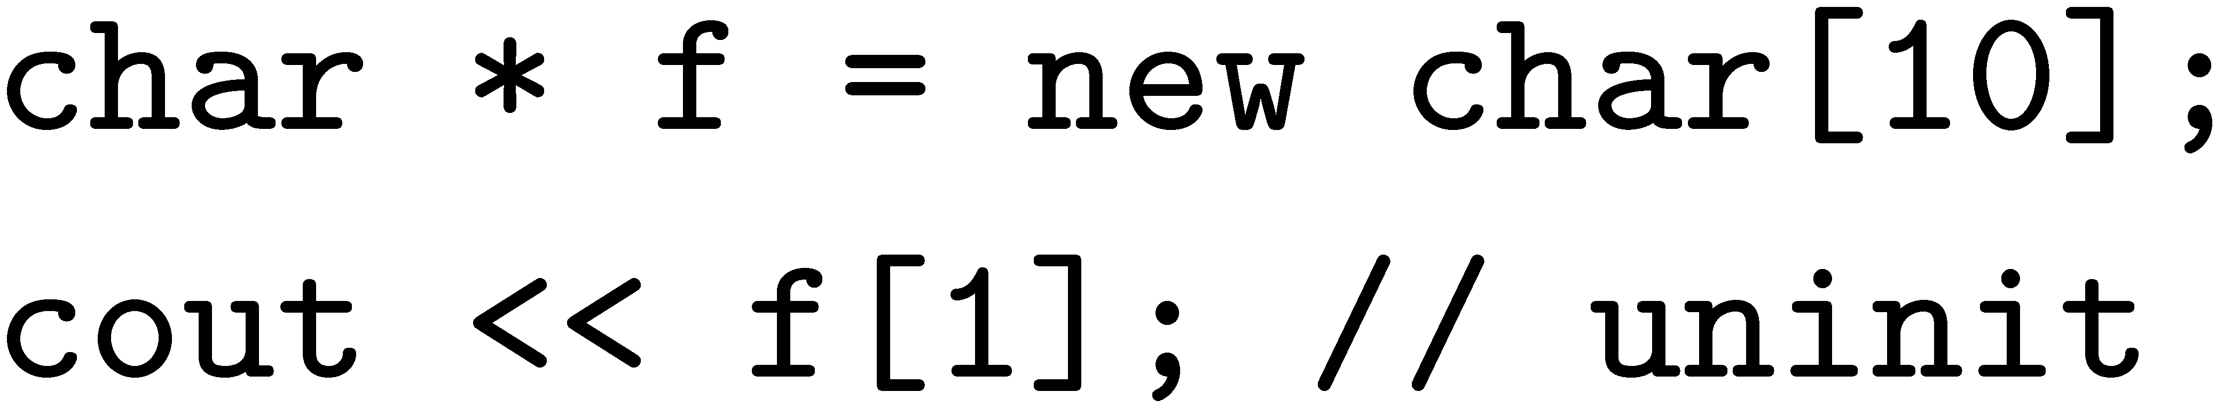
Uninitialized Reads
object
free space
C/C++ standard – undefined value

Slide 81
DieHard, heap layout
object size
allocation space
8
1
2
4
3
6
5
inUse
6
inUse
inUse
bitmap
2
4
16
1
inUse
miniheaps
1
inUse
1
Bitmap-based, segregated size classes
Bit represents one object of given size
i.e., one bit = 2^{i+3} bytes, etc.
malloc(): randomly probe bitmap for free space
free(): just reset bit

